Slide 1

Welcome to our presentation showcasing the innovative
BLOCKCHAIN-BASED PUBLIC GRIEVANCE MANAGEMENT SYSTEM
A pioneering solution engineered to revolutionize the challenges inherent in traditional policing systems, particularly within India. Our system elevates transparency, fortifies security, and streamlines operational efficacy. Enabling secure online filing of First Information Reports (FIRs) while ensuring decentralized record-keeping for enhanced privacy, this solution, adorned with intuitive dashboards and seamless blockchain integration, empowers both citizens and law enforcement agencies alike.

Slide 2
Addressing Limitations:
Analyzing Challenges:
Current crime reporting systems in the Indian Police Department suffer from inefficiencies, vulnerabilities, and lack transparency,
prompting the need for change.
Manual processes hinder effective public grievance management, urging the identification and analysis of these challenges
Emphasizing Trust and Privacy:
Why this project?
Enhancing Efficiency:
Highlighting the significance of trust, accountability, and privacy in public services, particularly in crime reporting, by implementing blockchain technology and smart contracts.
The objective is to significantly improve the efficiency of crime reporting within the Indian Police Department.
Proposing Technological Solution:
Establishing Decentralized Governance:
Introducing the Blockchain-Based Public Grievance Management System aims to leverage Polygon blockchain technology
to revolutionize the filing and management of First Information Reports (FIRs).
Creating a decentralized governance model ensures transparency, accountability, and safeguarding of sensitive information, nurturing public trust in the grievance management system.

Slide 3

Problem Definition
The Indian Police Department relies on manual processes causing inefficiencies, delays, and vulnerabilities in public grievance management.
Need for Technological Intervention: Urgent requirement for a modern, secure platform to streamline FIR filing.
Current manual systems lack transparency, leading to deception in FIR registrations. Ensuring trust, accountability, and due process is crucial.
Manual systems raise privacy fears, deterring crime reporting.

Slide 4
Objective of our Proposed Technique
Shift from traditional to smart method
Blockchain Technology in Public Services
Smart Contracts and Decentralized Governance
use of cryptographic techniques to ensure security
Ensuring Privacy with transparency
Streamlining FIR Process
Ensuring trust through code
Interoperability with Ethereum and Polygon

Slide 5

System Analysis / Proposed Scheme
Enhanced Security
Implementation of robust security measures protects user data, ensuring confidentiality and integrity throughout the system
Accessibility Improvement
Online reporting enhances convenience for citizens, facilitating easier submission and tracking of grievances from any device.
Immutable Records
Blockchain integration ensures that grievance registration and resolution records are transparent and immutable, enhancing accountability.
Data Integrity
Blockchain technology safeguards against data manipulation or corruption, preserving the accuracy and reliability of grievance records.
Innovation Catalyst
Adoption of advanced technologies like blockchain drives innovation in law enforcement practices, modernizing grievance management systems.

Slide 6
Feasibility Study
Technical
Our team concluded that blockchain is a feasible technology for FIR management due to its immutability and transparency.
Economic
Implementing a blockchain-based FIR system is estimated to reduce costs by up to 60%.
Operational
The system's decentralized nature improves operational efficiency by eliminating intermediaries in the FIR management process.
Legal
The use of blockchain technology promotes transparency and adds a layer of security to the FIR management process, making it legally compliant.

Slide 7
SOFTWARE ENGINEERING PARADIGM (Agile Principle)
Cross ­Functional Teams
The development team consists of individuals with diverse skill sets, fostering collaboration and ensuring expertise in frontend, backend, blockchain integration, and security is readily available within the team.
Customer Collaboration Continuous collaboration with client is integral to the Agile approach. Regular feedback sessions and demonstrations ensure that the system aligns with user expectations and needs.
4
3
Adaptability to Change
As the project progresses and stakeholders gain more insights, adjustments can be made to ensure the final product aligns closely with the evolving needs.
User­ Centric Design
Agile places a strong emphasis on user involvement throughout the development cycle with user stories and feedback .
2
5
1
6
Iterative Development
The project is divided into iterations, commonly known as sprints, each lasting a specific timeframe. This allows for the incremental development of features and functionalities, ensuring that usable increments are delivered regularly .
Regular Reflection and Adaptation At the end of each sprint, a retrospective is conducted to reflect on what went well, what could be improved, and what changes should be implemented in the next iteration. This continues reflection and adaptation contribute to ongoing process improvement.

Slide 8
Hardware & Software Requirements
Hardware
Network Infrastructure
Server Infrastructure
Software
Development and Deployment
Frontend technologies
Backend Technologies
Blockchain Integration
Cloud Hosting, Virtual Machine, Database Server, Blockchain Node, IPFS and Filecoin Nodes, Load Balancer
High Speed Internet Connection,
Firewall and Security Measures
Git, Docker, Alchemy
React.js, Ether.js, Web3 wallet
FastAPI , PostgreSQL, Redis, Firebase, Nginx
Polygon, Smart Contracts, IPFS and Filecoin Nodes

Slide 9
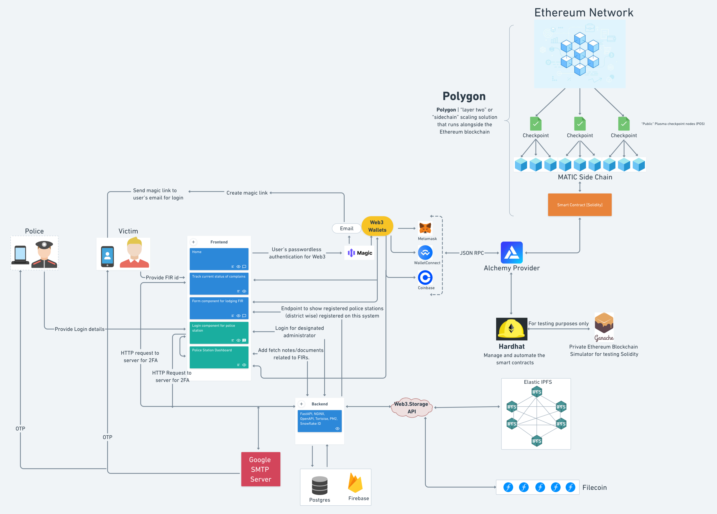
System Design

Slide 10
Blockchain Integration
1
Solidity and Smart Contracts
Solidity used for writing smart contracts on Ethereum blockchain to implement features such as filing and updating FIR securely. Smart Contracts are immutable and transparent ensuring integrity of the overall system.
Polygon (Ethereum based)
2
Polygon, a multichain scaling solution compatible with Ethereum used for its ability to offer faster and more cost-effective transactions while maintaining security and decentralized inherent in Ethereum network.
Compatibility with Ethereum: Polygon’s compatibility with Ethereum positions it as an ideal solution, inheriting the security features of the Ethereum network.
Proof­ of ­Stake (PoS) Consensus Mechanism: Polygon employs a Proof ­of ­Stake (PoS) consensus mechanism, enhancing energy efficiency and security compared to the Proof ­of ­Work (PoW) mechanism used by Ethereum ensuring sustainability and security.
3
Data Security and Privacy
Ensuring the security and privacy of user data is paramount in our design.
Encryption and Decentralization: Blockchain encryption techniques are employed to enhance data security, reducing the risks of breaches.
IPFS and Filecoin Integration: combination of Inter-Planetary File System(IPFS) and Filecoin is used to store FIR files securely in a decentralized manner.

Slide 11
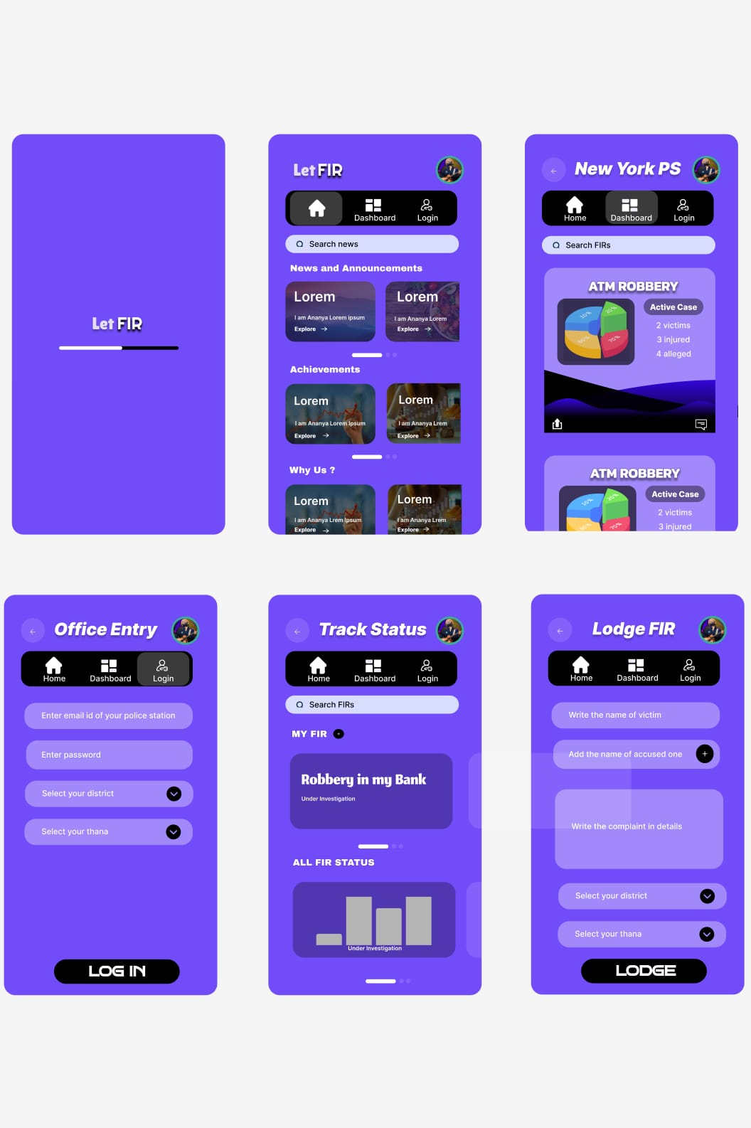
Frontend
1
React.js
React.js used for creating dynamic and responsive web application.
User Dashboards
2
Two distinct dashboards for specific need of victims and police stations.
Victim Dashboard to enable victims to lodge and track FIR without need for physical visits to police stations.
Police station dashboard to efficiently access and manage reported crimes by acting as a centralized hub.
3
User-friendly Design
Emphasis is placed on creating an intuitive and user­-friendly design to ensure that users can navigate the dashboards effortlessly.
Seamless Interaction
4
The design focuses on facilitating seamless interaction between users and the system.

Slide 12
Backend Architecture
Autonomous Services
1
Authentication Services: Encompasses activities such as registering police stations, email address verification.
OAuth2 flow securely authorizes and authenticates police officers.
Data related to authentication and authorization is stored in PostgreSQL DB and Firebase.
JSON Web Tokens (JWTs) to establish and maintain authenticated sessions.
Location service: dedicated to the management and handling of location related queries.
Identification service: Leveraging the Twitter Snowflake algorithm with a single cluster configuration, this service ensures the efficient and reliable creation of unique IDs.
General Utility service: offers a diverse range of functions crucial for the overall system functionality.
Web3 storage used for efficient file uploads.
Subject Lists used to provide access to a comprehensive list of subjects relevant to FIRs enhances the system’s overall utility.
2
FastAPI Framework
FastAPI is used for building APIs with Python 3.7+ Its asynchronous design ensures efficient handling of requests, contributing to the overall responsiveness of our system.
3
Integration and Orchestration
To facilitate seamless interaction among these services, a responsive reverse proxy server, nginx, is implemented.
Nginx manages flow of requests, ensuring efficient communication between frontend and backend services.
Integration of Redis as a caching mechanism further enhances system responsiveness, reducing load on upstream servers and improving overall efficiency.

Slide 13
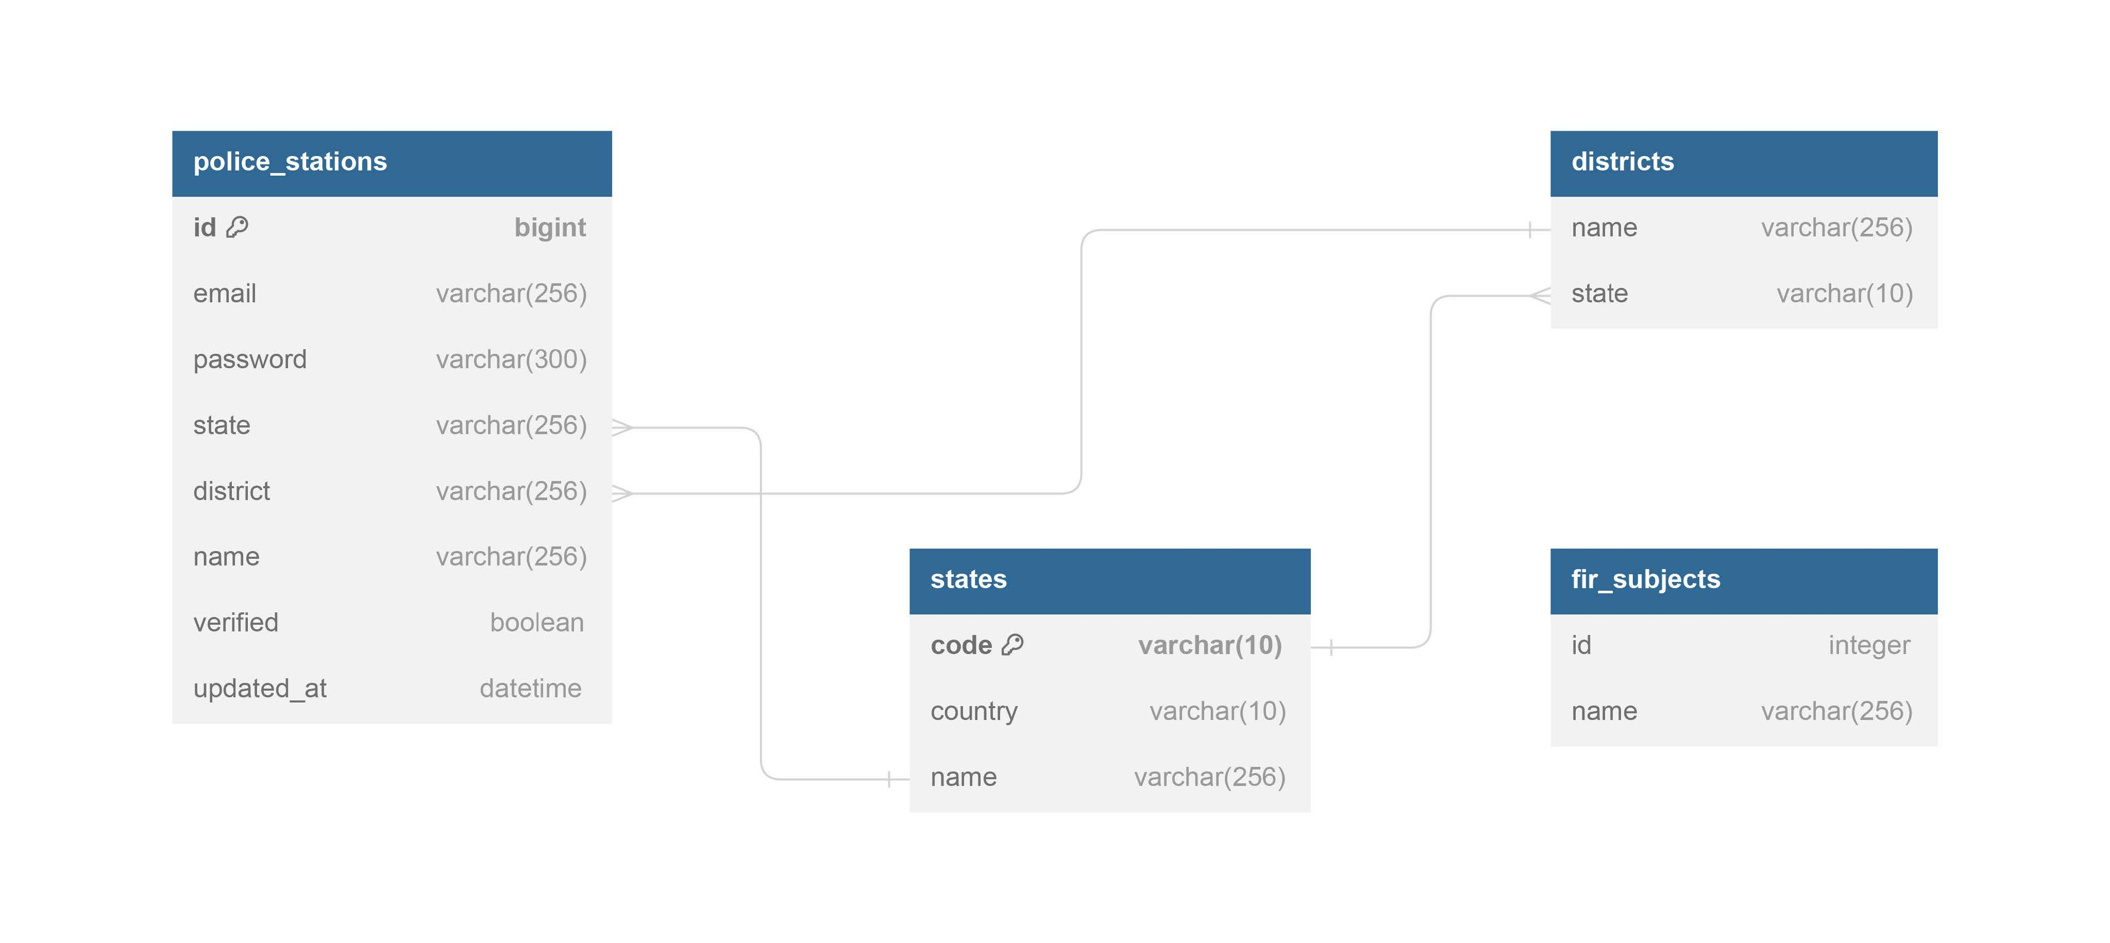
DATABASE DESIGN
Schemas
The fir_subjects table stores the record of all the available topics under which the user is going to FIR.
The states table contains the detail of the states such as its name, code and country.
The districts table records the details of the district like the name, code of the states where it belongs.
The police_stations table keeps track of all the details of the police station.

Slide 14
Enhanced Transparency and Security
Improved Efficiency and Accessibility
Blockchain technology ensures immutable records, fostering trust in the system’s integrity
Citizens can easily report incidents and
track grievances online, reducing physical visits and streamlining processes.
Strengthened Collaboration and Adaptability
Positive User Feedback
Agile methodologies enabled continuous collaboration, resulting in a system closely aligned with user needs.
Result
Initial responses highlight the system’s user ­friendly interfaces and effectiveness in grievance management.
Potential Impact on Public Safety
Cost Efficiency
While further evaluation is needed, the system shows promise in
enhancing public safety and trust.
The system has saved costs by cutting
paperwork and optimizing resource use, ensuring taxpayer funds are used effectively.

Slide 15

01
Enhanced Mobile Accessibility with various screen sizes and devices.
Incorporate AI and Machine Learning.
02
Future
Works
04
User Education and Onboarding provide for both citizens and police officers.
User Feedback Mechanism with Multilanguage Support.
03

Slide 16
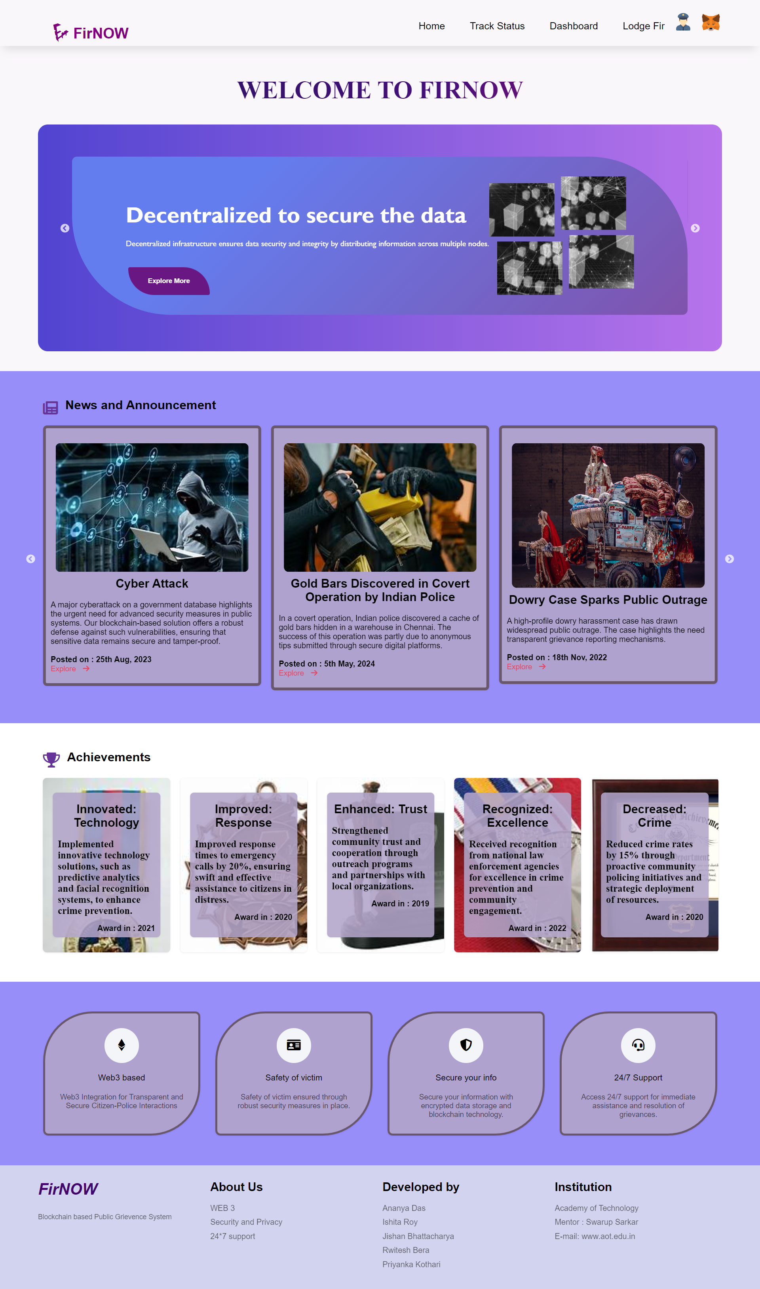
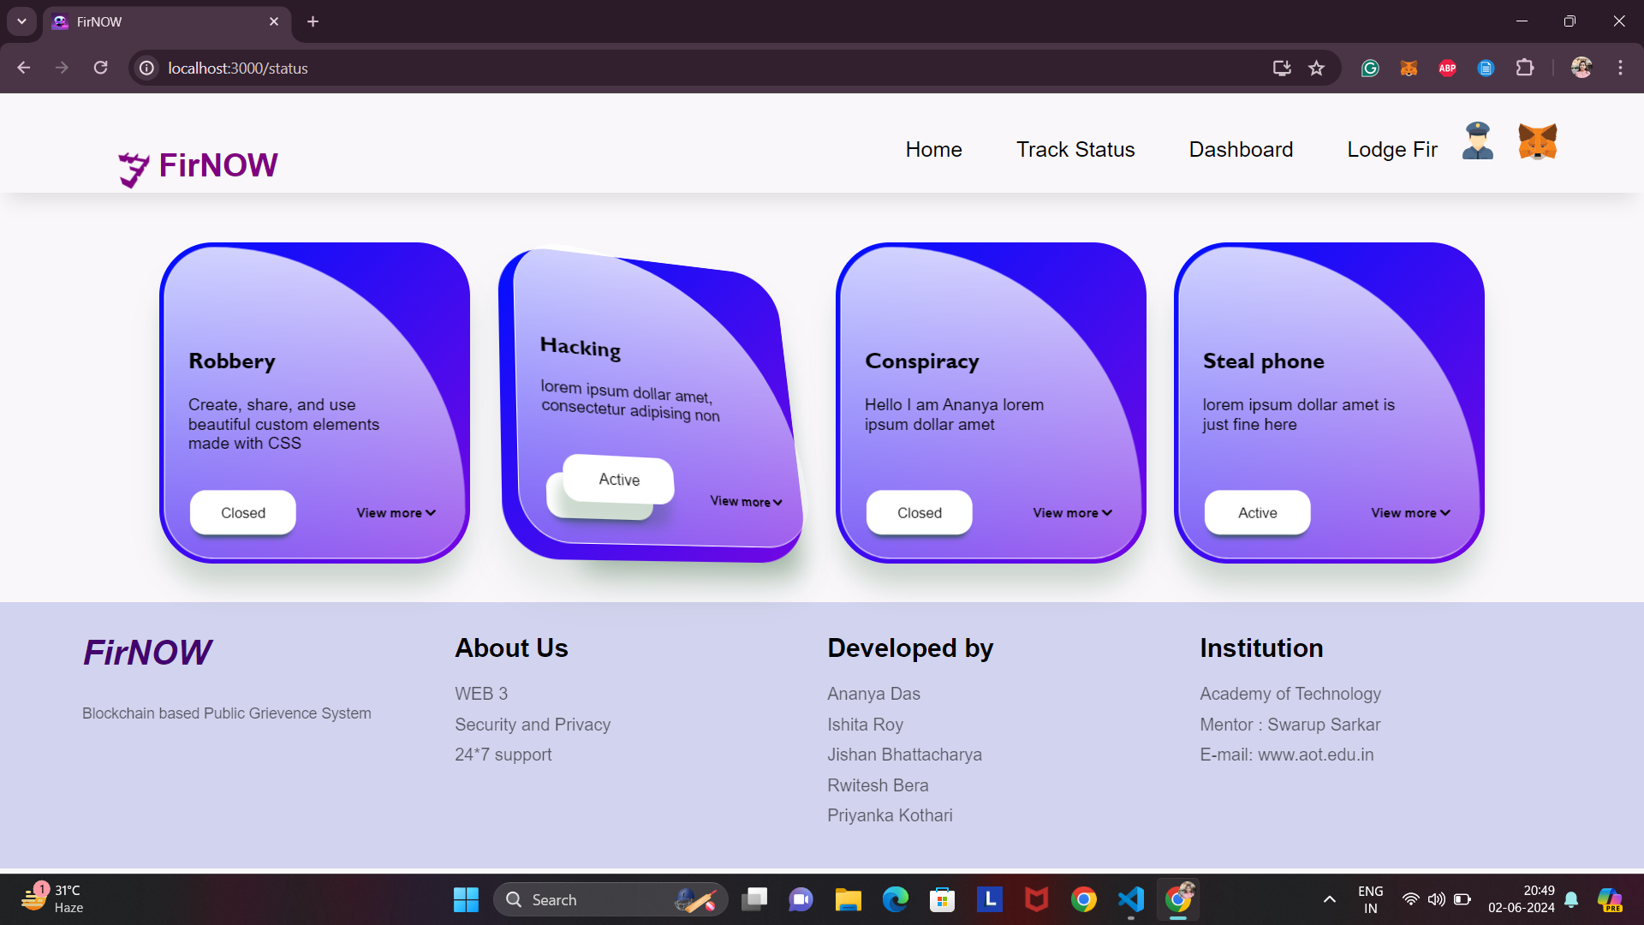
Flow of the project
Track Status page
Home page

Slide 17
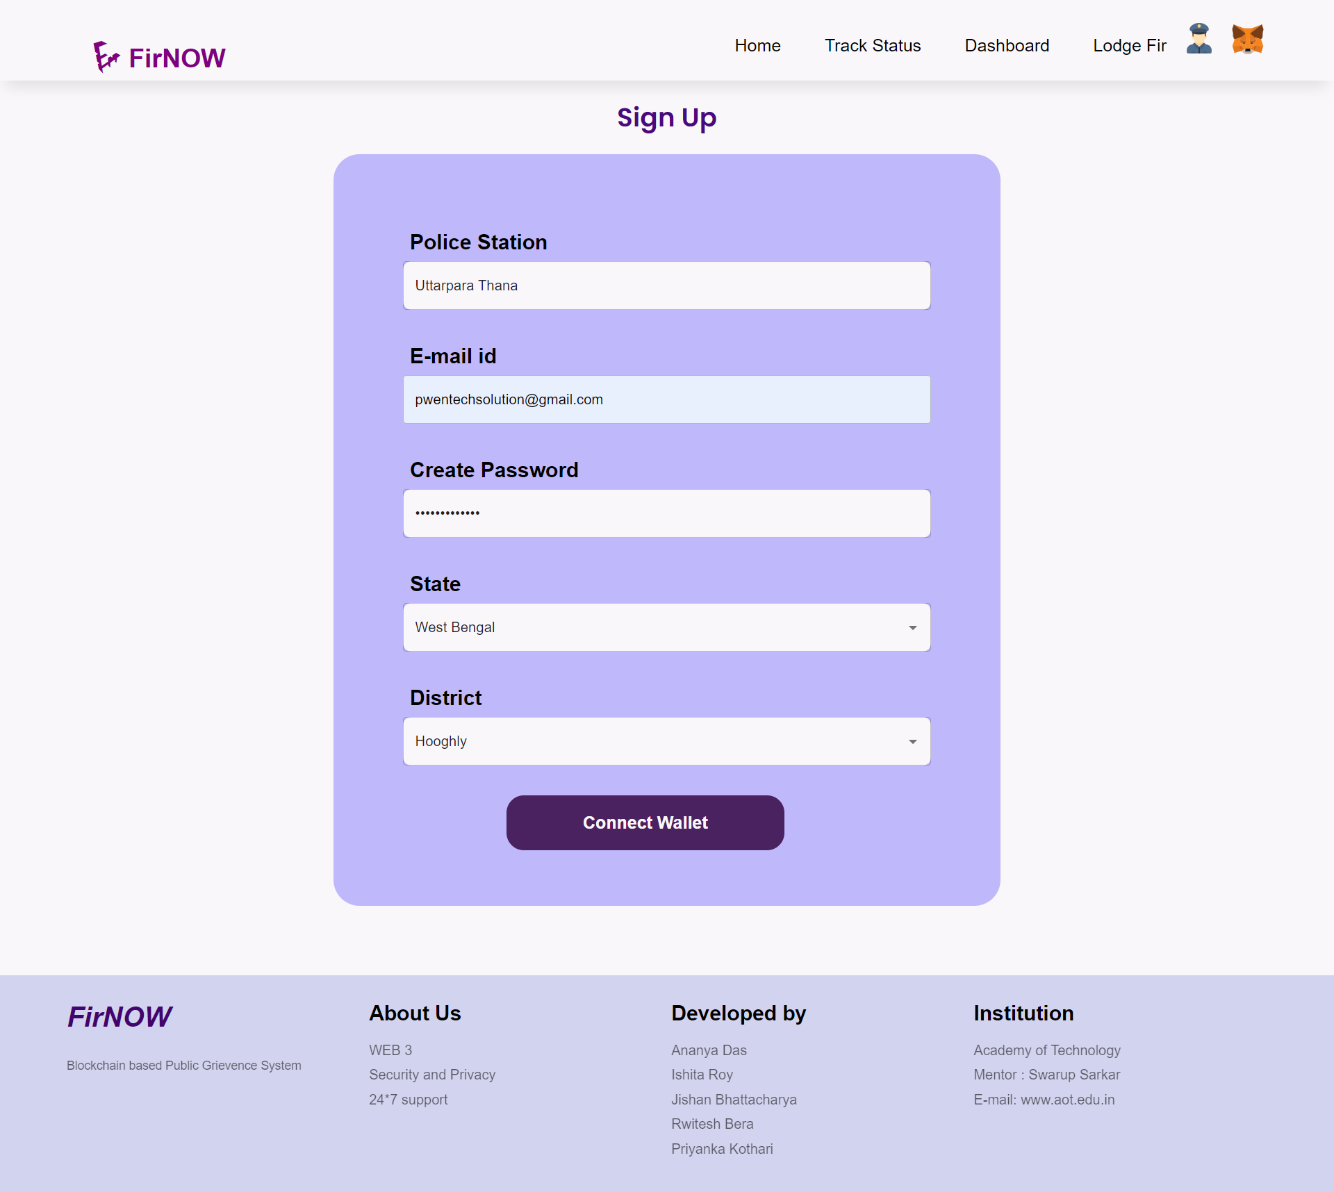
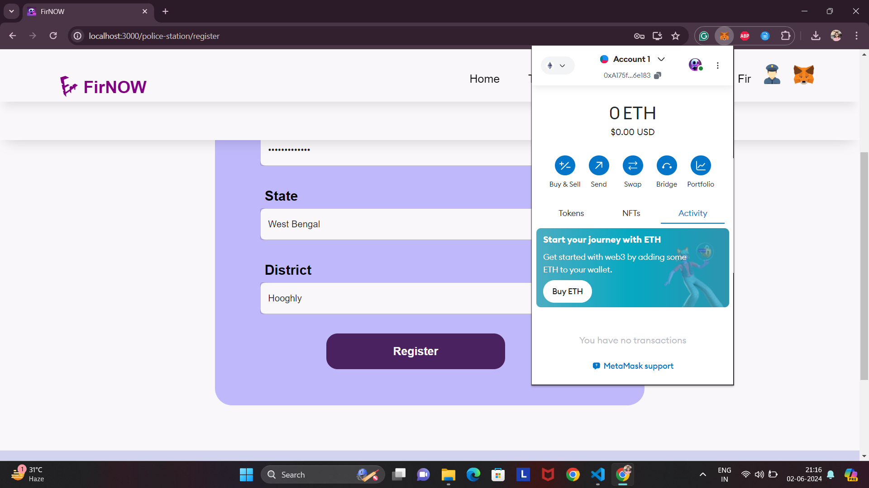
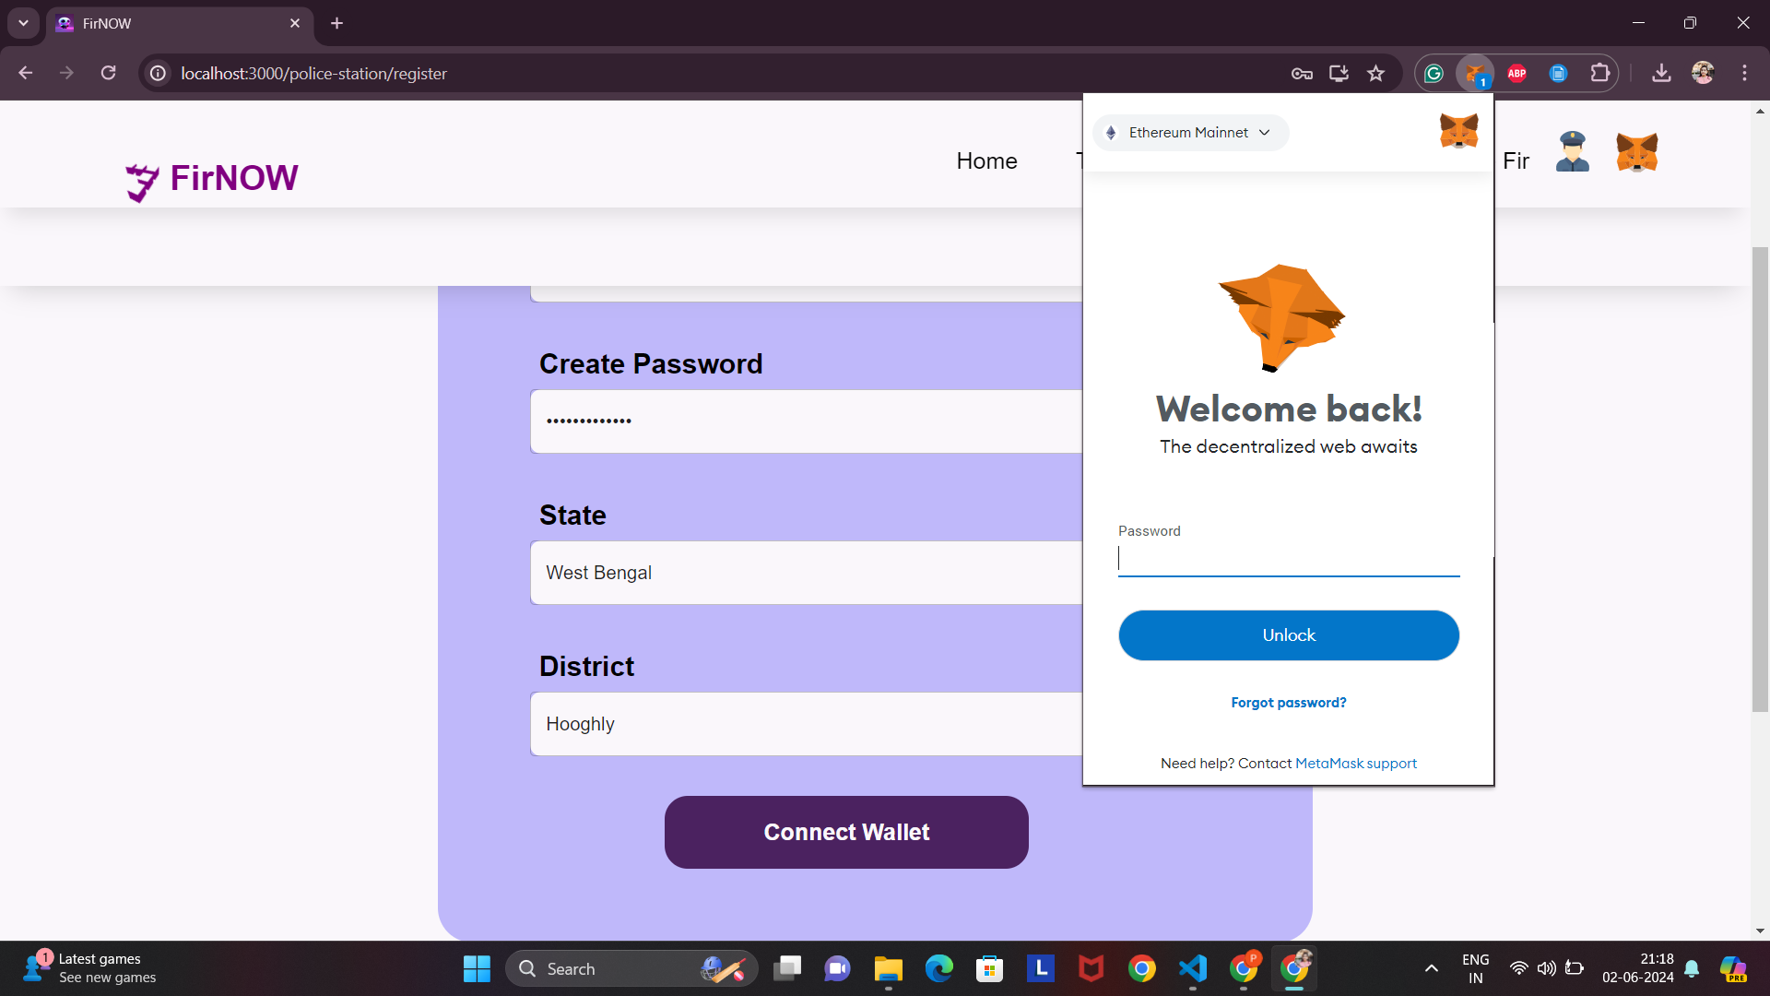
Registration
After clicking on Connect Wallet button, MetaMask
login should be done and then Register button will be visible for registration.

Slide 18
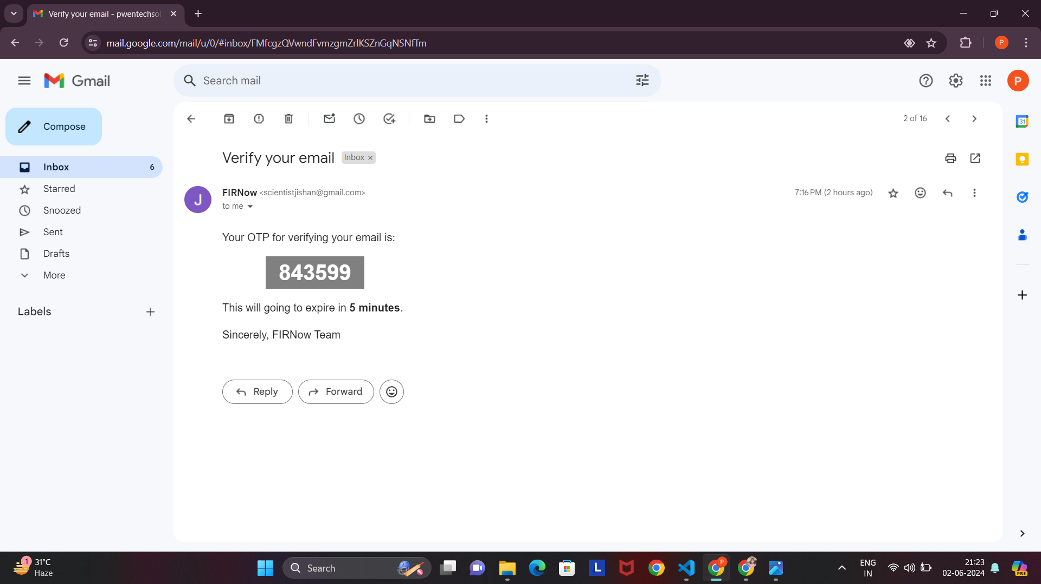
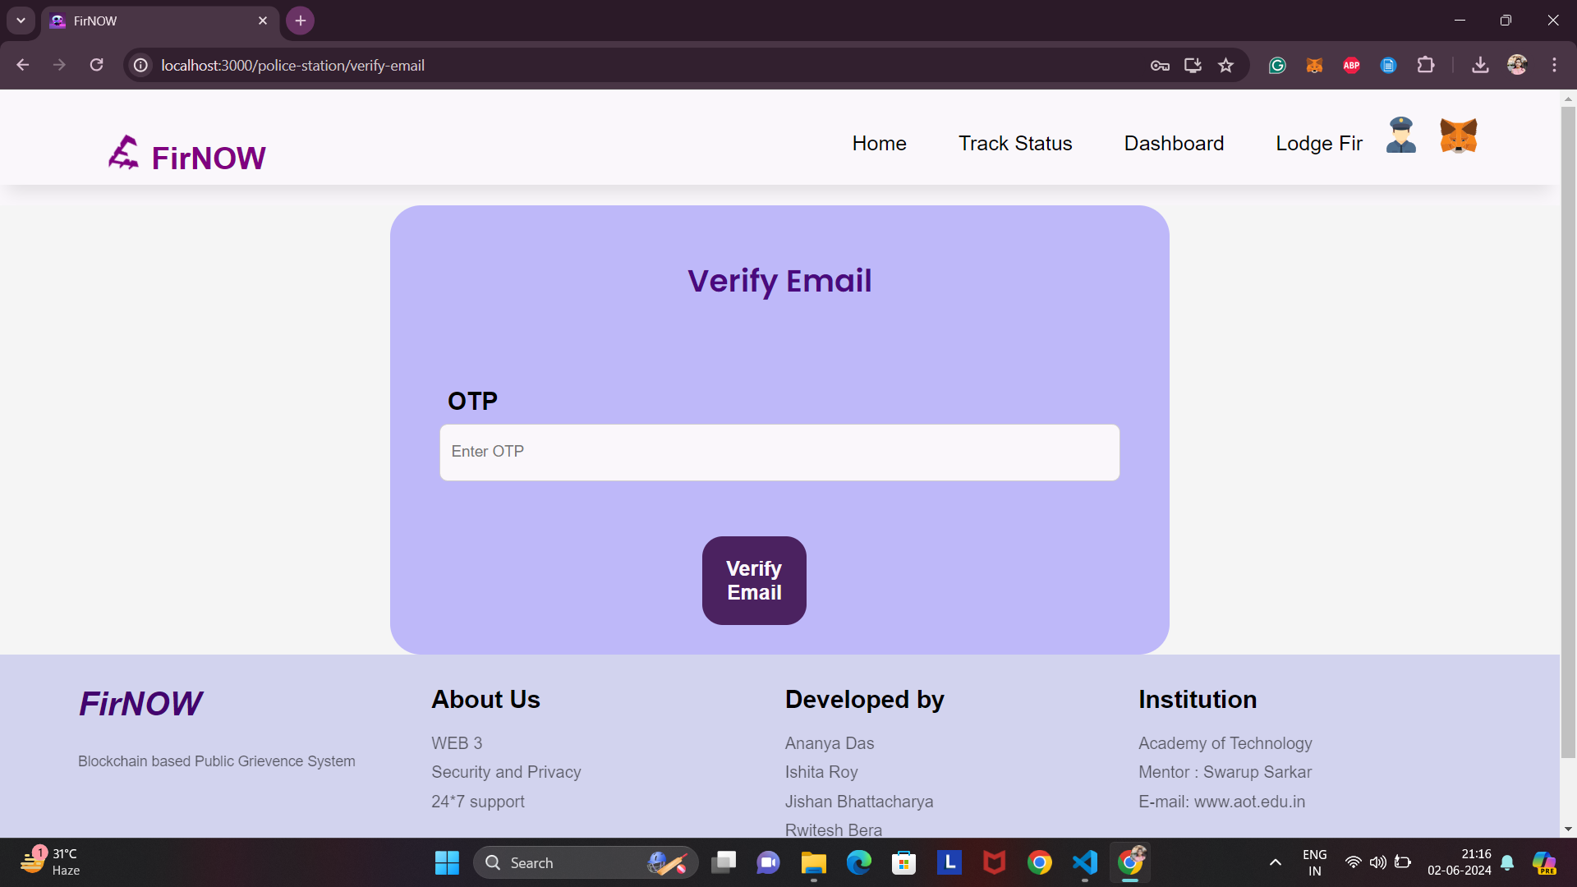
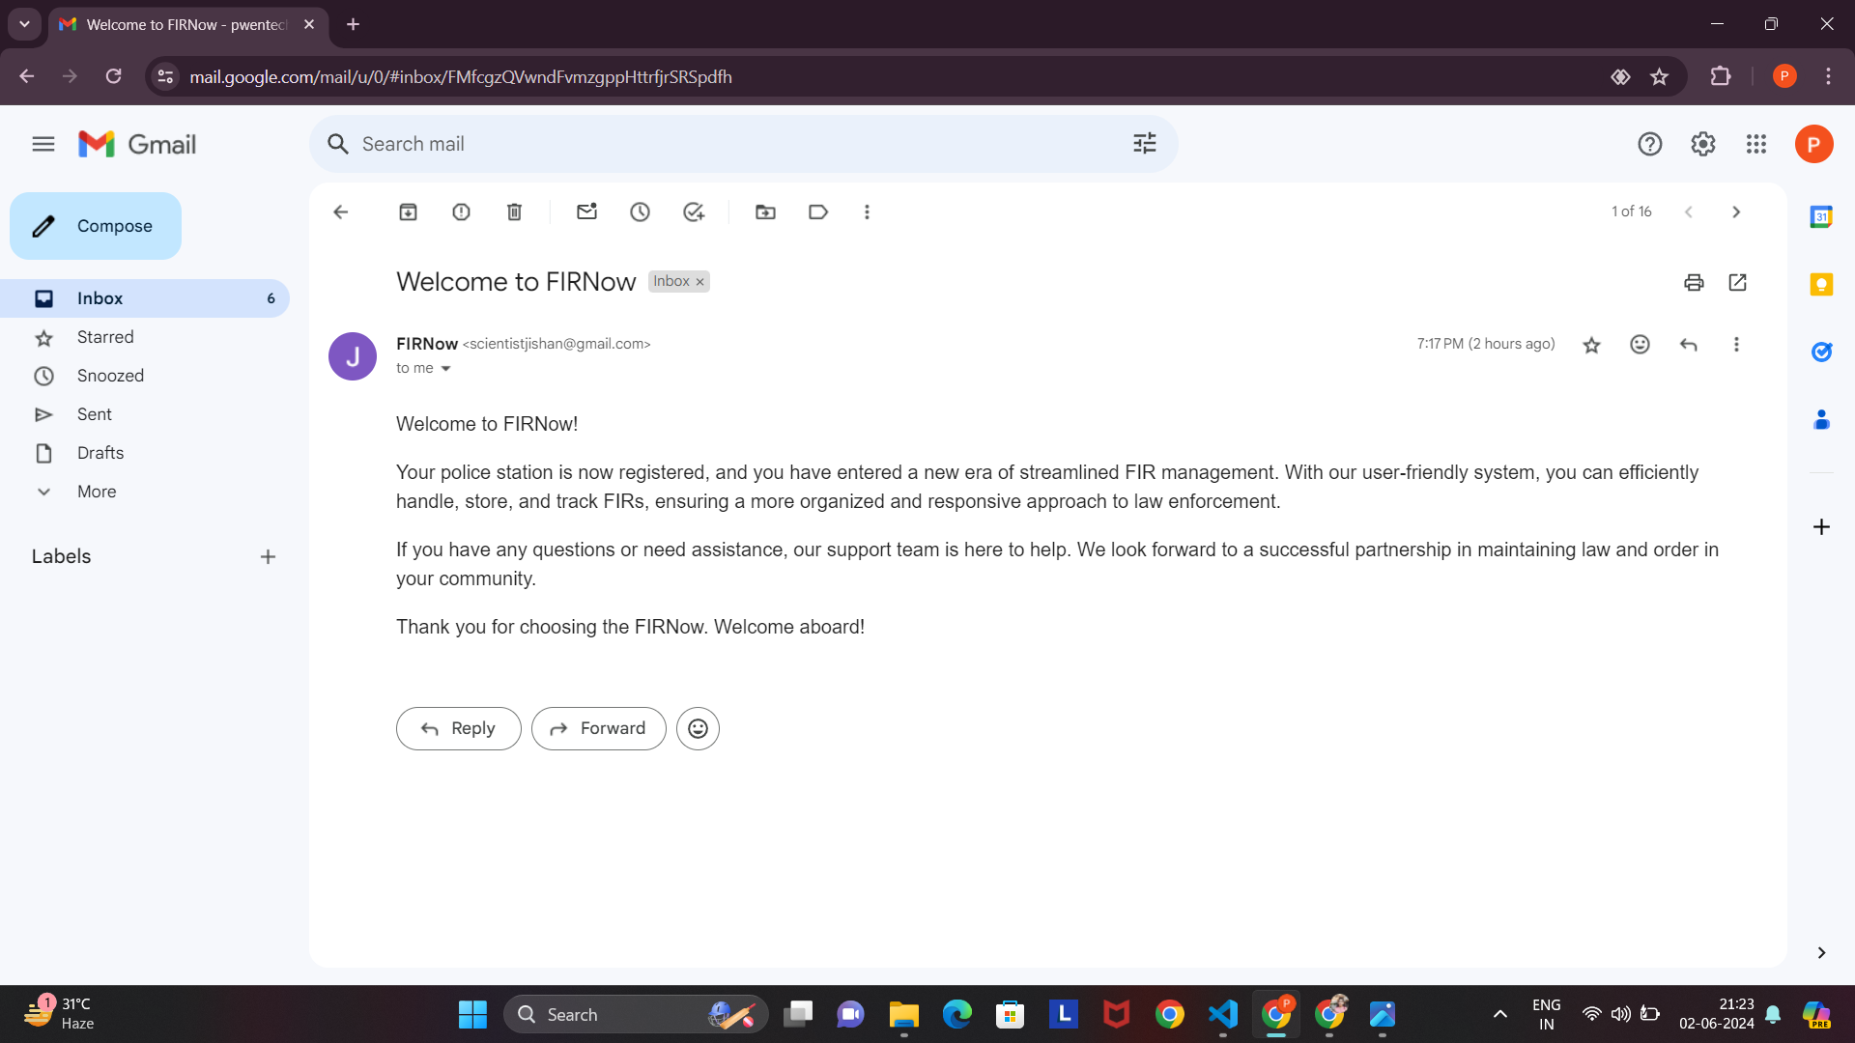
OTP verification
After clicking on register button OTP verification page will appear and OTP will be sent to the user’s mail which will be used to verify the user. Welcome mail will also be sent after registration.

Slide 19
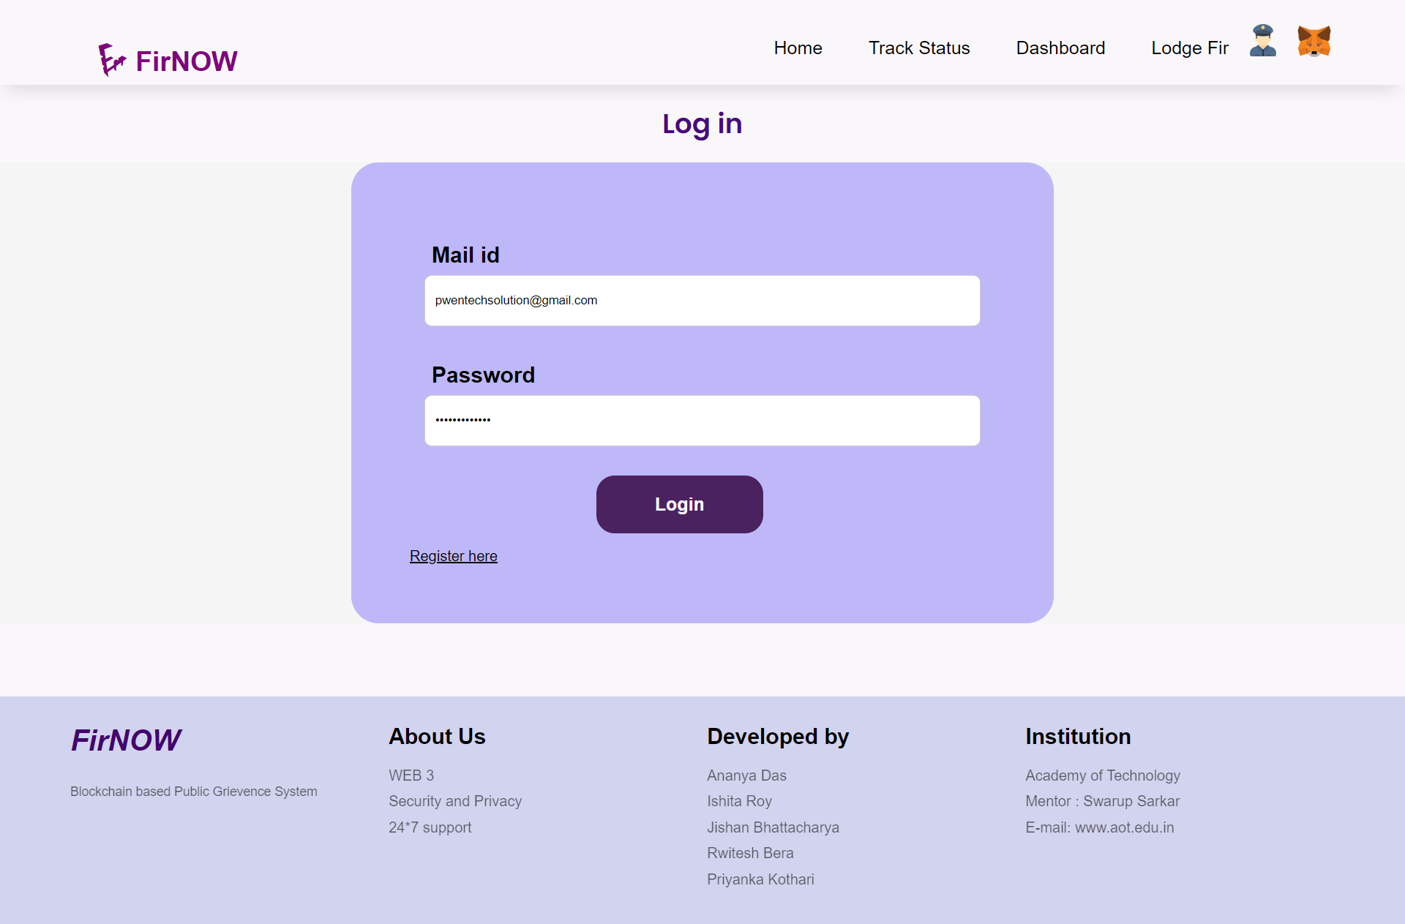
Login

Slide 20
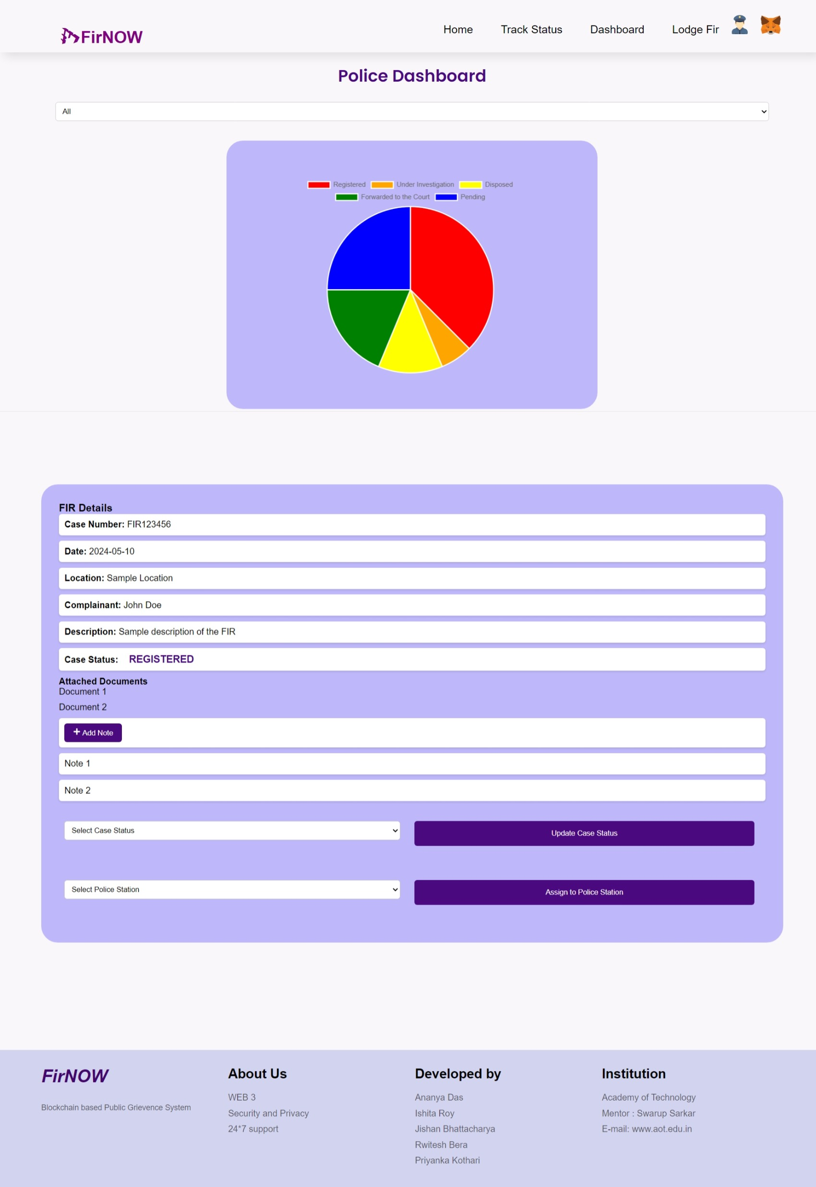
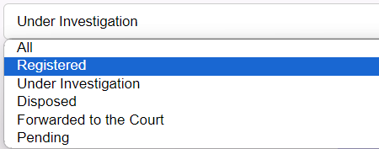
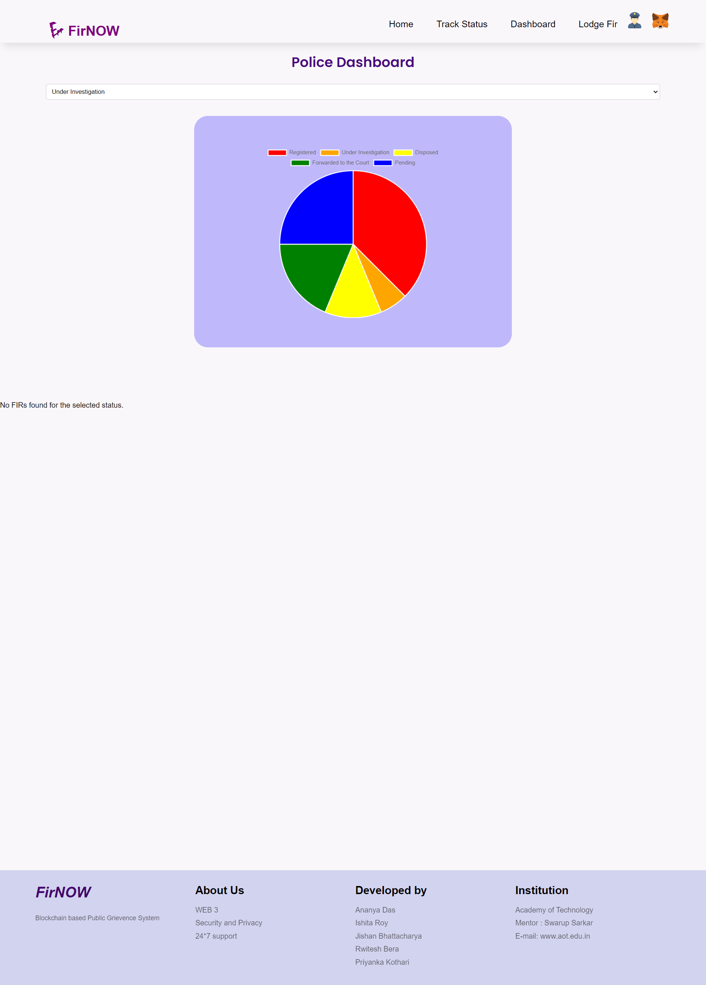
Police Dashboard
5 different status of cases
If there is no cases under any status, it doesn’t show any file.

Slide 21
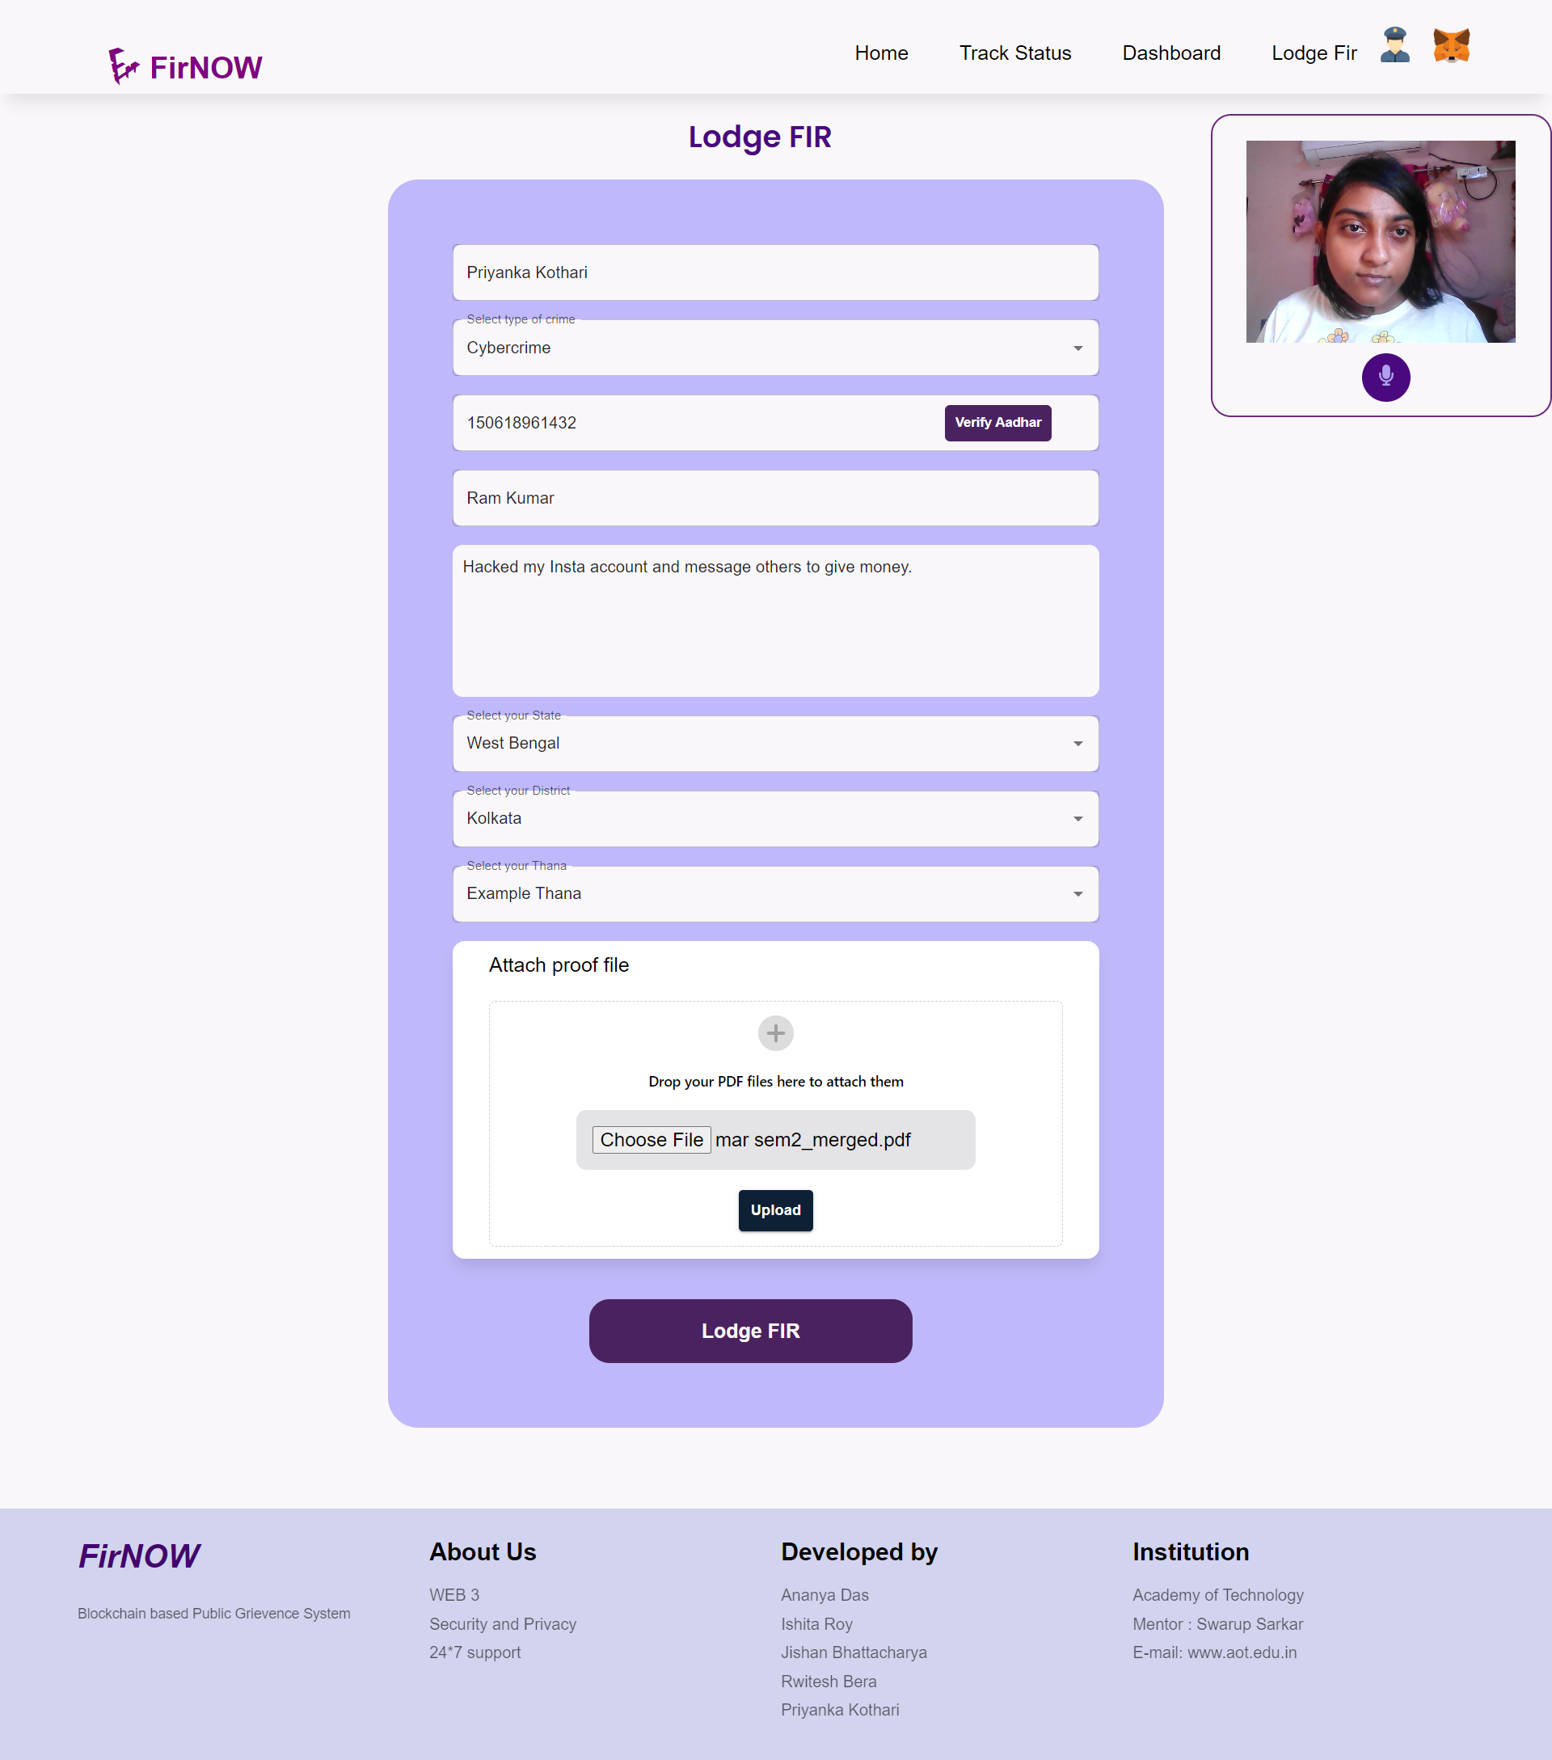
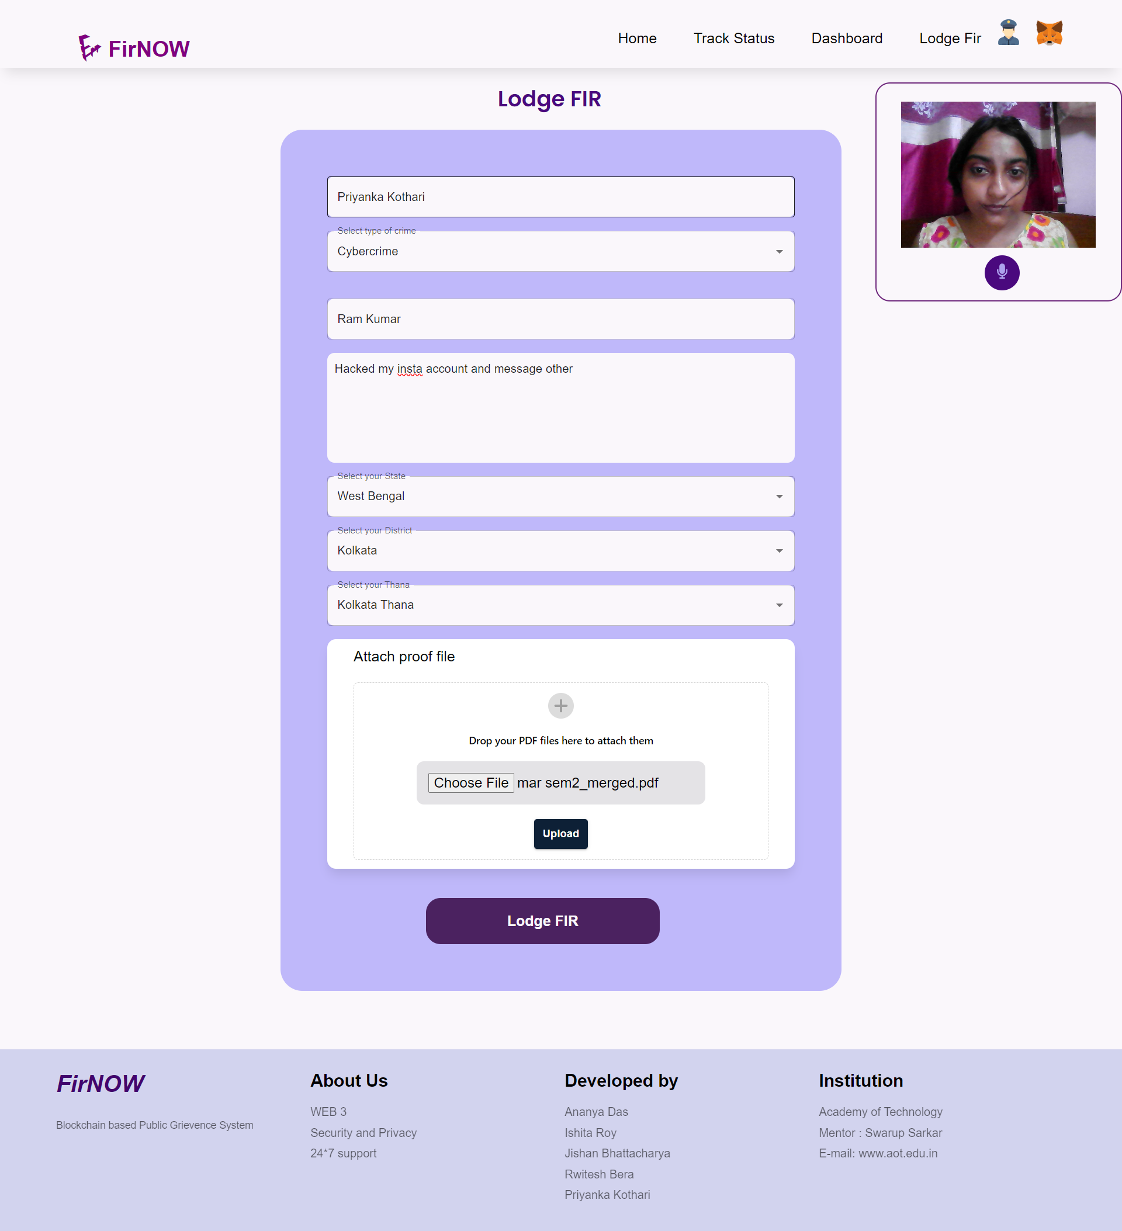
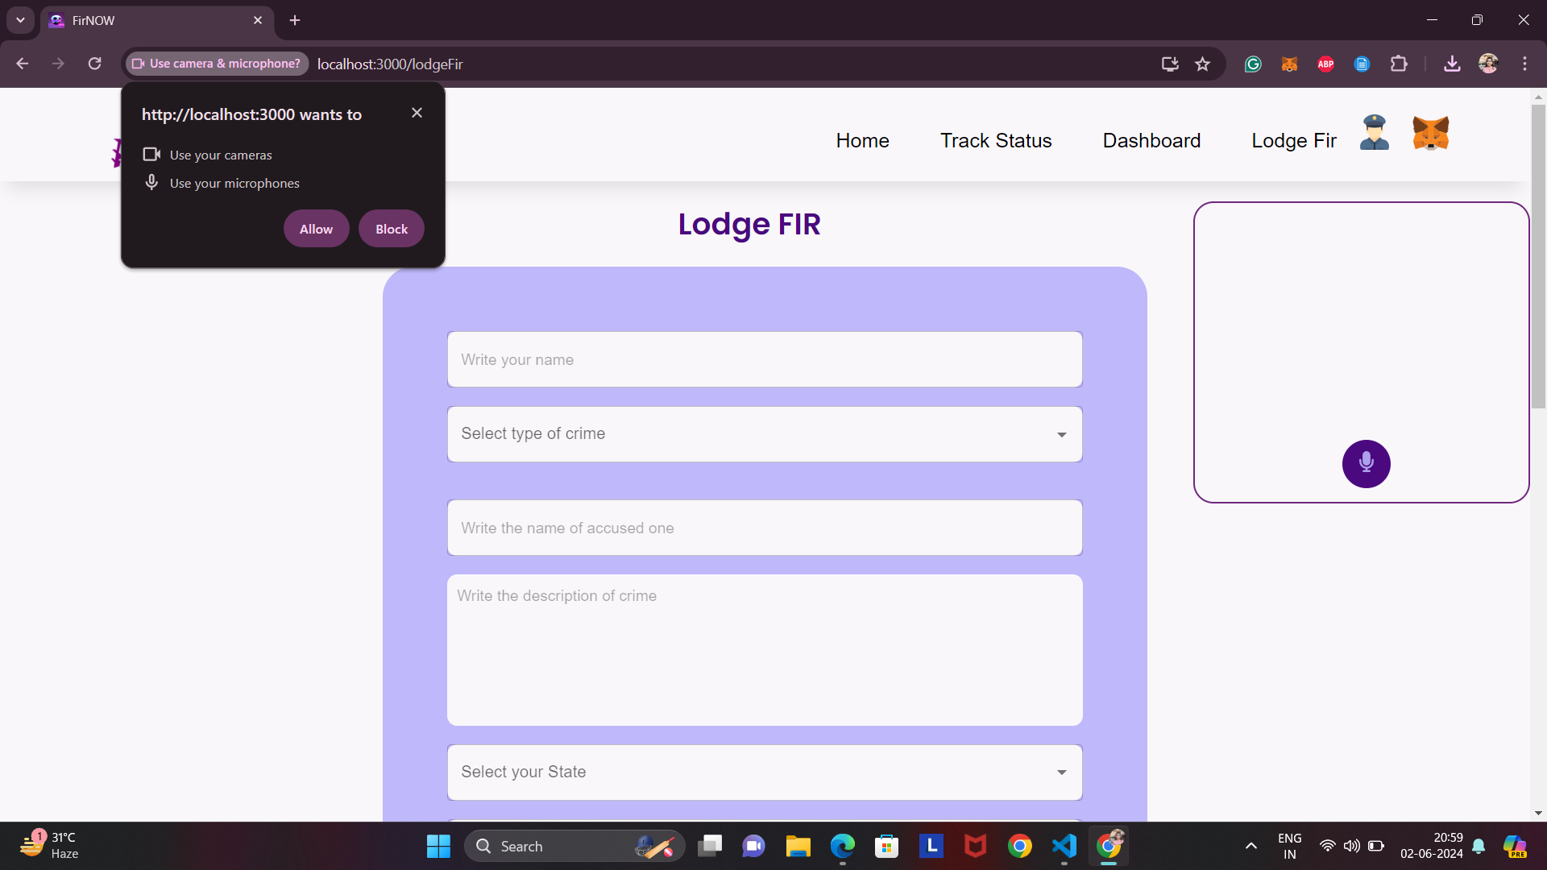
Lodge FIR
When a user want to lodge the FIR, at first user should give access to camera and microphone, so that we can record the user lodging FIR to verify the authenticity of the user and catch malpractices.

Slide 22
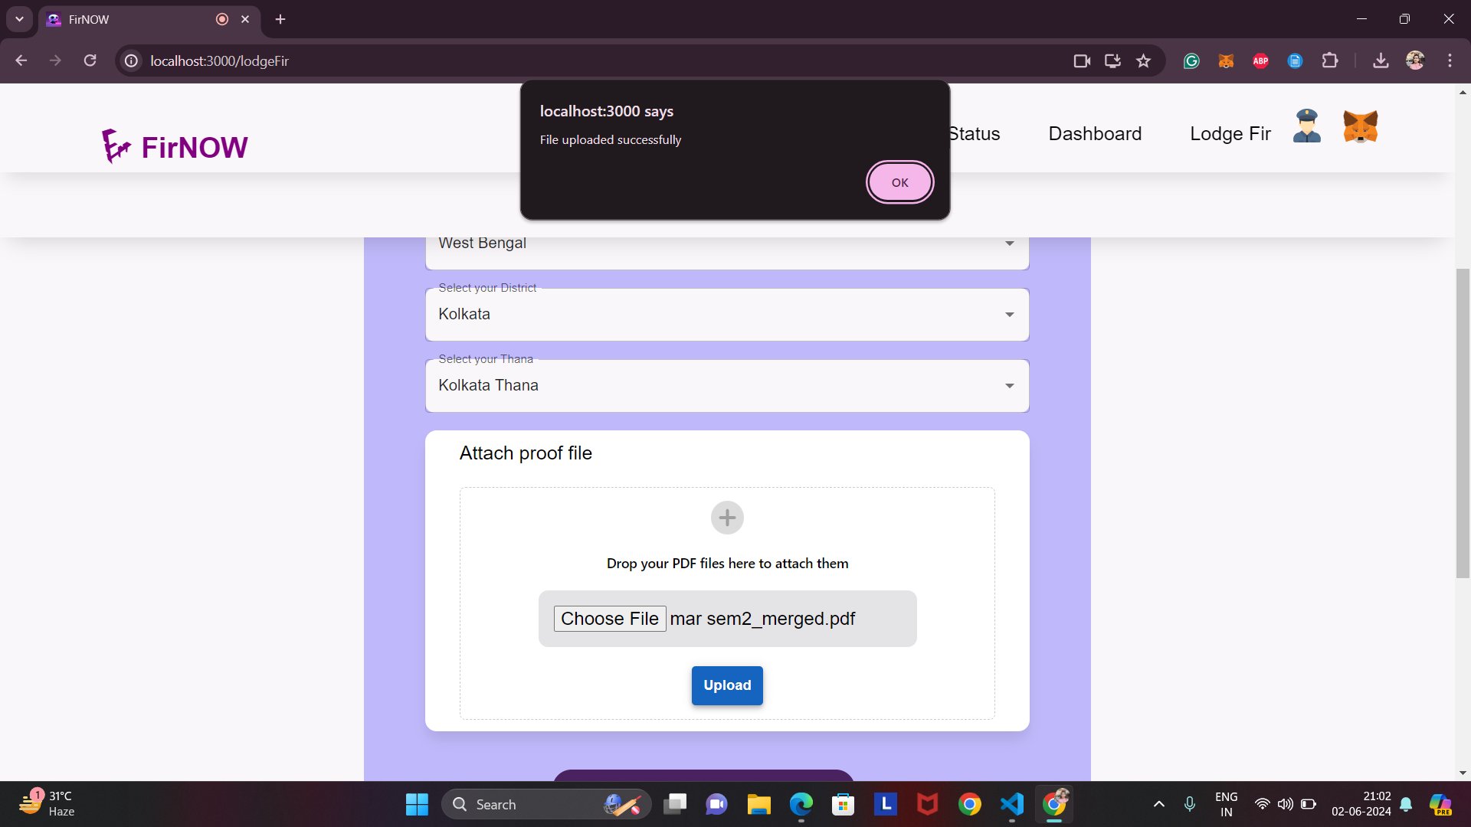
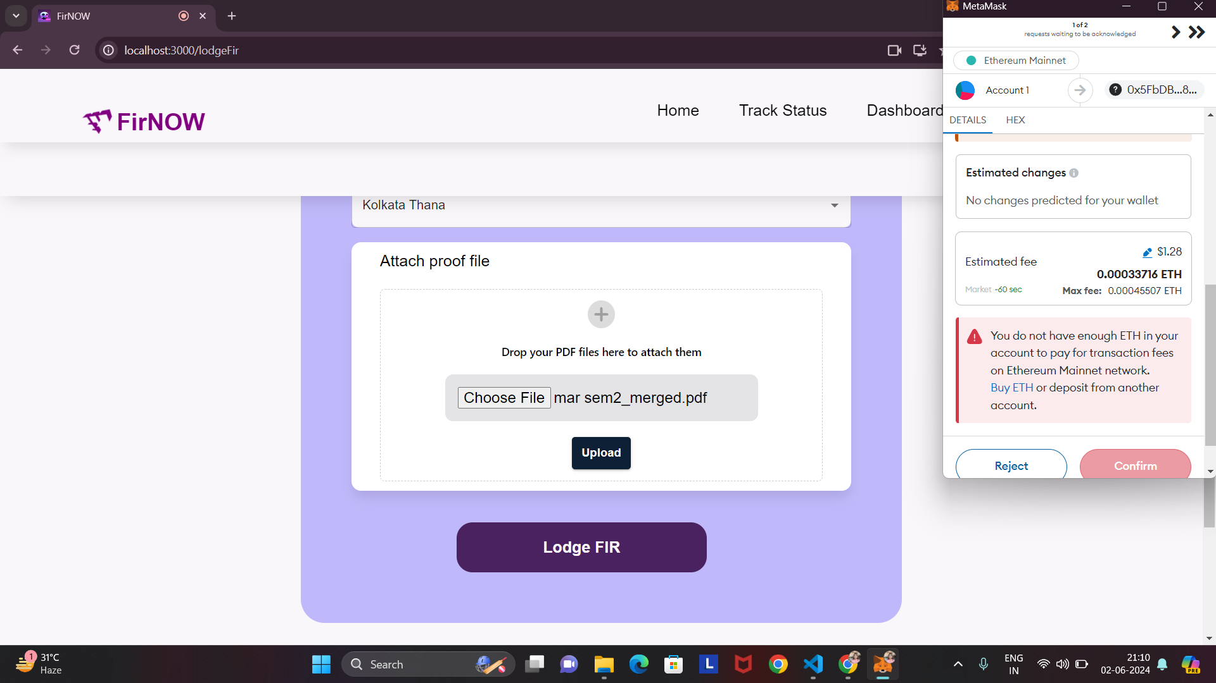
When the Lodge FIR button will be clicked a WEB3 based Decentralized transaction should be made first and paid the transaction fees using Bitcoins and then lodge FIR successful message will be shown.
When the user upload a PDF file, “File Uploaded Successfully” pop-up appears and the file is not in PDF format “File Upload Failed” status appears.

Slide 23
Backend APIs

Slide 24
Team Members
Ananya Das
Priyanka Kothari
Ishita Roy
Rwitesh Bera
Jishan Bhattacharya

Slide 25

Thank You
Ask us if you have any query

